Slide 1


“Assuring Ultrapure Quality of Neutral Alcohol for Vodka & Gin – An Overview”
Binod Maitin
FlavorActiV Limited, UK
Technical Seminar
New Delhi , February 7-8, 2019
Global Sensory Excellence

Slide 2
Contents
Neutral Alcohol - Quality Imperatives
Off-notes & Specifications
Fermentation & Distillation Imperatives
Monitoring & removal of congeners traces
Effective Analytical Methods
Sensory Evaluation Methods
Sensory Proficiency

Slide 3
Grain Neutral Spirit (GNS) or Extra Neutral Alcohol(ENA)
High-purity potale ethanol ( 96 % ABV ) from agricultural crops
Base for premium vodka, gin, & several speciality spirits
Neutral smell and taste and negligible impurities are critical
Even after multiple distillations traces of congeners remains causing unacceptable odours

Slide 4
Neutral Alcohol Purity is critical
Any off note from impurities/contamination adversely affects
Product sensory quality
Aroma & flavour profile,
Consistency and stability
Effect on post-consumption well-being ( Taste , Hangover, Toxicity)
Neutral spirits can exhibit objectionable off notes beyond MDL of analytical instruments but fall within sensory threshold of panellists
Structured sensory panellists training and regular proficiency calibration enhances trustworthiness of sensory quality decisions

Slide 5
Sensory Analysis vs. GC Analysis Data of Vodka

Slide 6


Slide 7
Consumer Perception & Health Concerns
Aldehyde Level
Causes Harshness & raw characters
Faster oxidation /less Blend Stability
Contributing to hangover / Carcinogenic
Methanol Content
Spirity/solventy/Pungency/ Causes faster oxidation
Faster Hangover /Toxic at higher level
Metabolizes by ADH & ALDH to formic acid causing blindness
N-Propanol Content
Causes harshness / Faster oxidation at higher level
Causes depression / Faster Metabolization by ADH & ALDH
Fusel Oil / Higher Alcohols
Pungent, Harsher burning sensation
Different profile, faster oxidation
Metabolizes slowly by ADH & ALDH
Contributing to hangover

Slide 8
Neutral Spirit Specifications for Off - Note Congeners

Slide 9
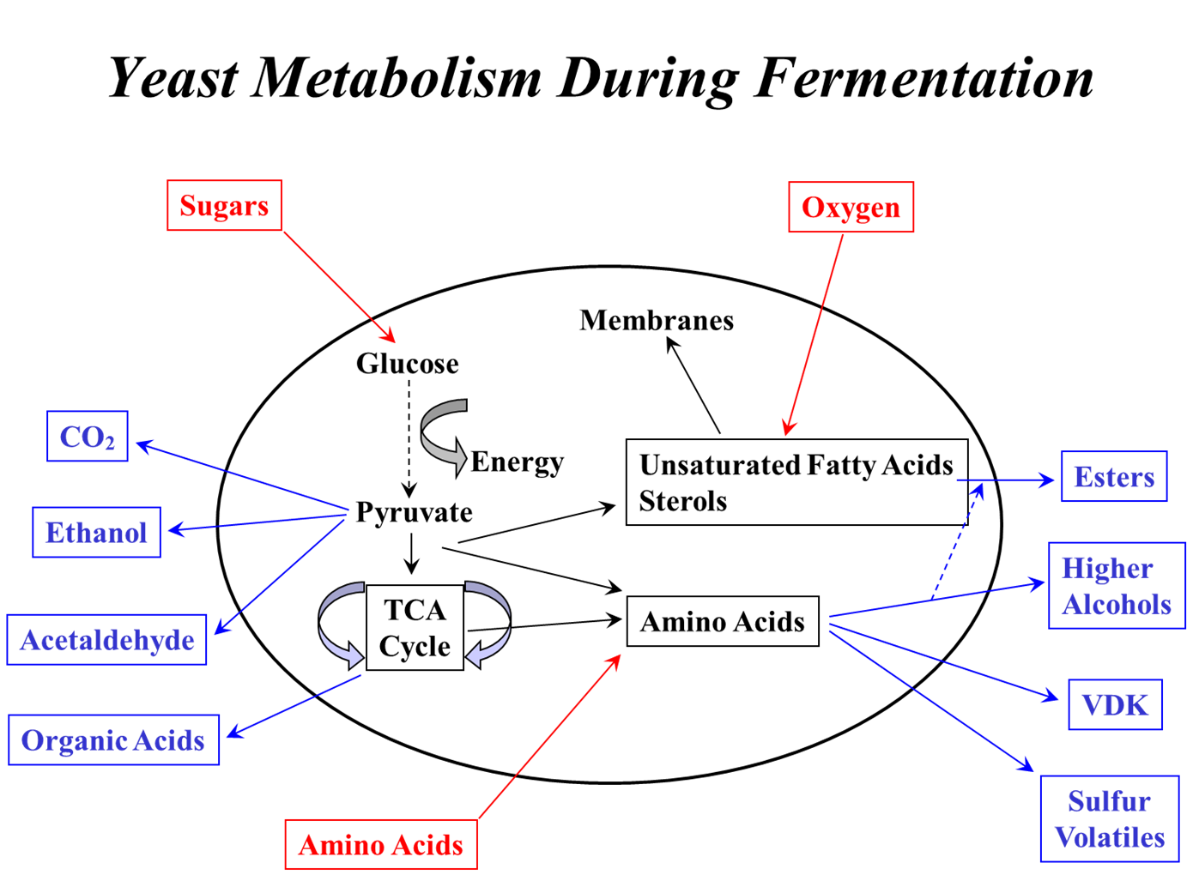
Congeners Formation during Fermentation

Slide 10
No Congeners Desired in Ultrapure Neutral Alcohol
GC Purity
Sensory Neutrality
UV purity
270nm | UV-Visible Spectrophotometric Test Method | abs | - | 0.0000
at 240nm |  | abs | - | 0.030
at 230nm |  | abs | - | 0.079
at 230nm
at 220nm |  | abs | - | 0.166

Slide 11
Critical Fermentations Imperatives
Consistent fermentation
Vitality
Rapidfermentation
Alcohol yield & consistent fermentation yield
Temperature/ Osmotic /Ethanol stress tolerance
Consistent temperature
Controlled pH condition
Competitive against lactic acid bacteria
Reduced yeast biomass producion

Slide 12
Critical Distillation Imperatives
Separate congeners with boiling points close to ethanol using hydro-selection/extractive distillation.
Demethylising column
Ozonation, activated carbon adsorption and gas stripping
Look at newer ideas : iStill Distilling with carbon extraxtor introduced recently for craft segment

Slide 13
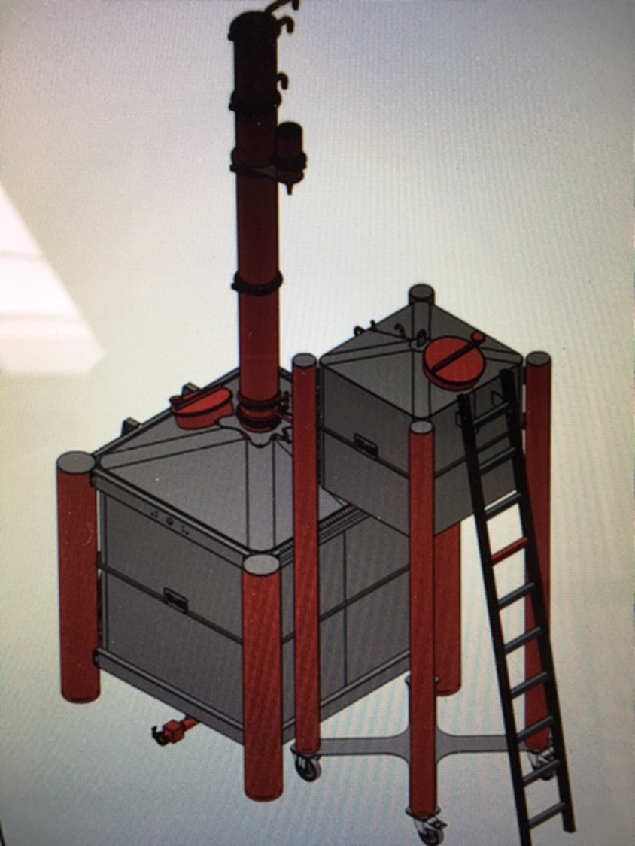
iStill Distillation With Extractor
Next generation alcohol production equipment
Helps the distiller with automated and robotized controls
To make either the best taste rich or neutral spirits
Utilizes carbon in the Extractor to remove congener traces

Slide 14
Monitoring & removal of Congener traces
Analytical Detection for monitoring Olfactry-GCMS, Electronic Nose / Tounge
Enhanced Sensory Sensitivity through Good Sensory Practices

Slide 15
Sensory Evaluation Methods for Neutral Spirits
Scoring (Ratio Scale 0 -10)
Threshold or Sensitivity Tests
Difference Tests
Triangle & Tetrad
Difference from Control (DFC)
An adaptation of Degree of Difference test
Deals with batch to batch variations.
Discrimination sensory testing with an identified control evaluate & scale perceived difference from control.
Category scale from “Not Different” to “Extremely Different”. !

Slide 16
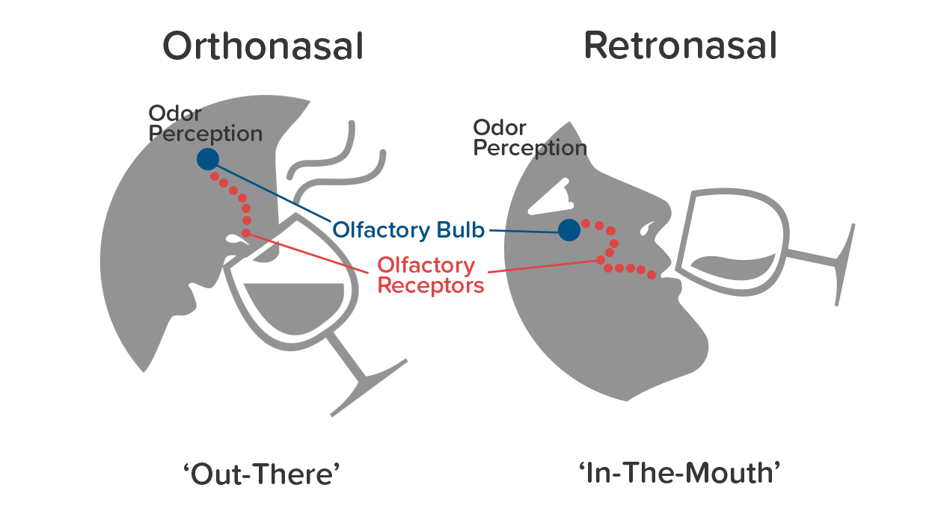
GMP Flavours Facilitates Retronasal Tasting
The Nose & Mouth are connected. Molecules released into the air inside our mouths as we chew and swallow travel up through the retronasal passage into the nose, then move up and contact the olfactory epithelium. Flavor is the combination of true taste (sweet, salty, sour, bitter) and retronasal olfaction and mouthfeel

Slide 17
Flavour release and transport in the mouth and nose

Slide 18
GMP Flavours For Sensory Panel Training and Proficiency Calibration

Slide 19
Structured approach in developing sensory skills

Slide 20
Method of Proficiency Assessment?
Measures & Calibrate sensory skills of spirit assessors
Gives a common language of typical off-notes in NS
Ultimately improves quality of the produced NS & NS based spirits beverages

Slide 21
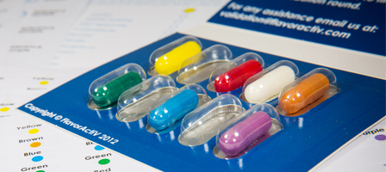
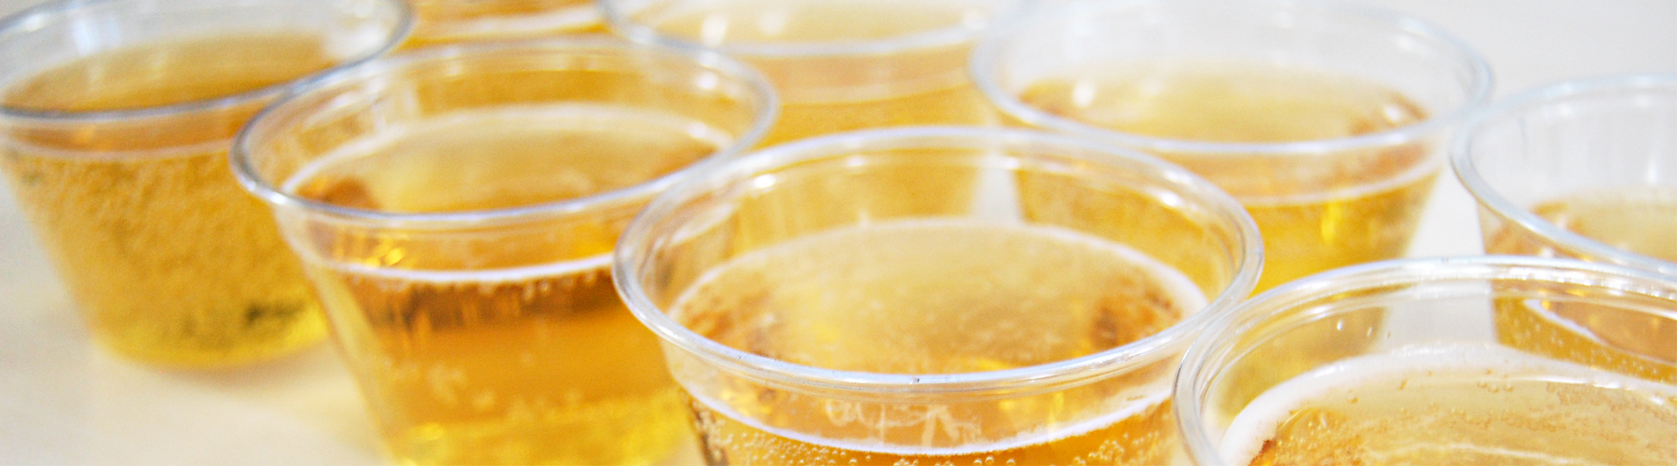

Proficiency - Taste
Produced to GMP Quality Standards
Colour coded format for easy use
Provided in Pharmaceutical blister packs – protected from air and moisture and easy to use
Documentation and labels provided
Test to results takes 30 mins

Slide 22
Sensory Proficiency Scheme –
Methods of Validation
Flavour Identification Validation:
Individual flavour identification using standard terminology
Rank Rating Validation:
Discrimination of different flavour intensities and scale them accordingly
In Profile Validation:
Primary focus on IN or OUT / meeting the brand‘s sensory profile – used by spirits customers

Slide 23
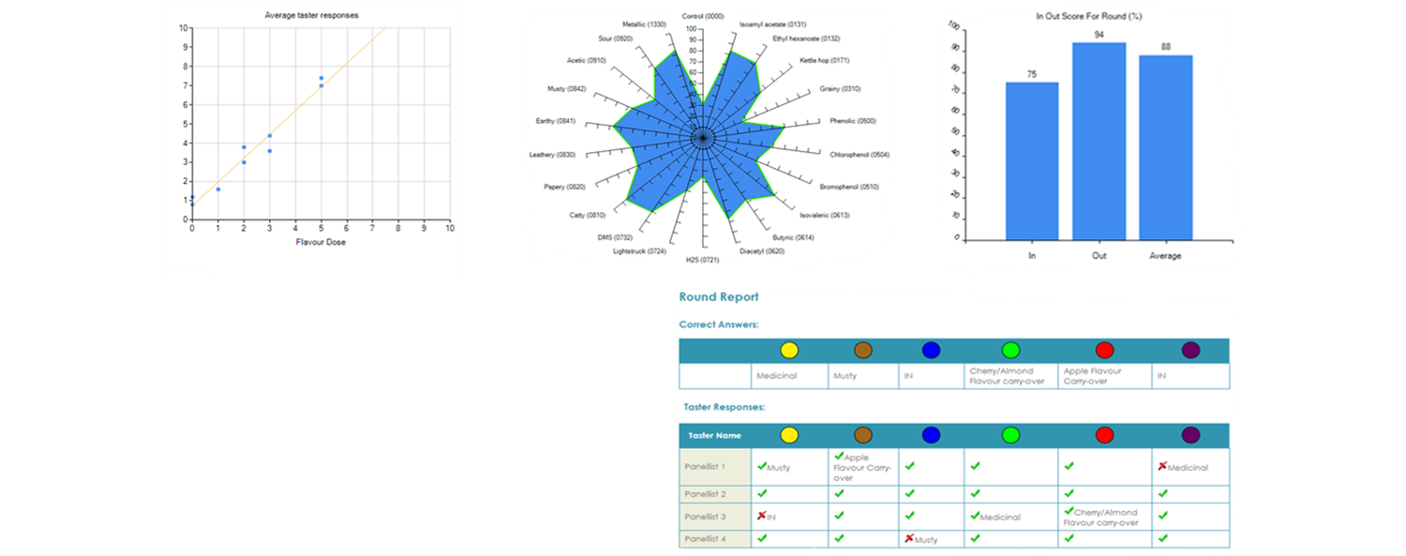
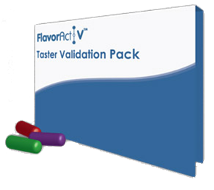
Assuring value from best sensory practices

Slide 24
Thank You
Questions ?

